Slide 1
Jenkins: Scripted Pipeline + SonarQube Analysis
SAGAR SAJI
245195

Slide 2
Jenkins: Scripted Pipeline
Jenkins is an Open-source automation server that facilitates the continuous integration and continuous deployment (CI/CD) of software projects.
It automate various stages of the software development lifecycle, including building, testing, and deploying applications.
Pipelines define the steps and actions necessary to build, test, and deploy software applications.
One of the pipeline is Scripted Pipeline
Uses Groovy Language to build processes.
More flexible and advanced customization.
Can use conditional statements like if-else or loops to define the workflow.

Slide 3
Scripted Pipeline: Jenkinsfile
Before using Scripted Pipeline in Jenkins for a spring boot application, we need to first add a Jenkinsfile into the spring boot application.
Jenkinsfile is a text file that serves as the configuration and definition file for Jenkins pipelines.
It reads and executes the instructions to automate the build, test, and deployment processes.
It specifies the steps, stages, and actions to be executed during the CI/CD process.
Enables version control, collaboration, and automation of their CI/CD processes.
Provides a structured and maintainable approach to defining and executing Jenkins pipelines.

Slide 4
Scripted Pipeline: Script Syntax
node {
stage('Build') {
// Build the application
bat 'mvn clean install'
// Perform additional actions within the build stage
sh 'echo "Build completed"'
bat './custom-script.sh'
}
stage('Test') {
// Run unit tests
bat 'mvn test'
// Perform additional actions within the test stage
bat 'echo "Tests completed"'
}
stage('Deploy') {
// Deploy the application to a server
bat 'scp target/app.war user@server:/path/to/deploy'
// Perform additional actions within the deploy stage
bat 'echo "Deployment completed"'
}
}

Slide 5
Jenkins: SonarQube
Integrating SonarQube with Jenkins allows you to perform static code analysis and generate code quality reports as part of your CI/CD process.
To Integrate SonarQube into Jenkins we need to install SonarQube-Scanner plugin from Manage Plugins which is in Manage Jenkins.
SonarQube server needs to be run on the system and should be accessed from localhost:9000
In the Script Pipeline, need to add a stage for ‘SonarQube-Analysis’ which is:
stage('SonarQube Analysis’) {
steps { withSonarQubeEnv('sonarserver') {
bat 'mvn clean install sonar:sonar’
}
}
}

Slide 6
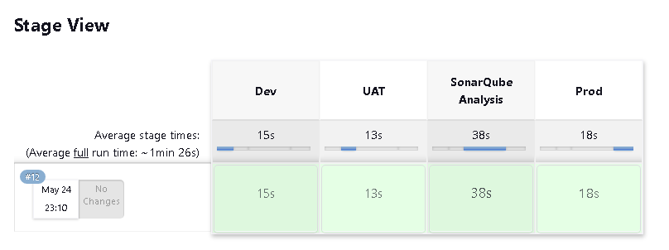
Jenkins Result

Slide 7
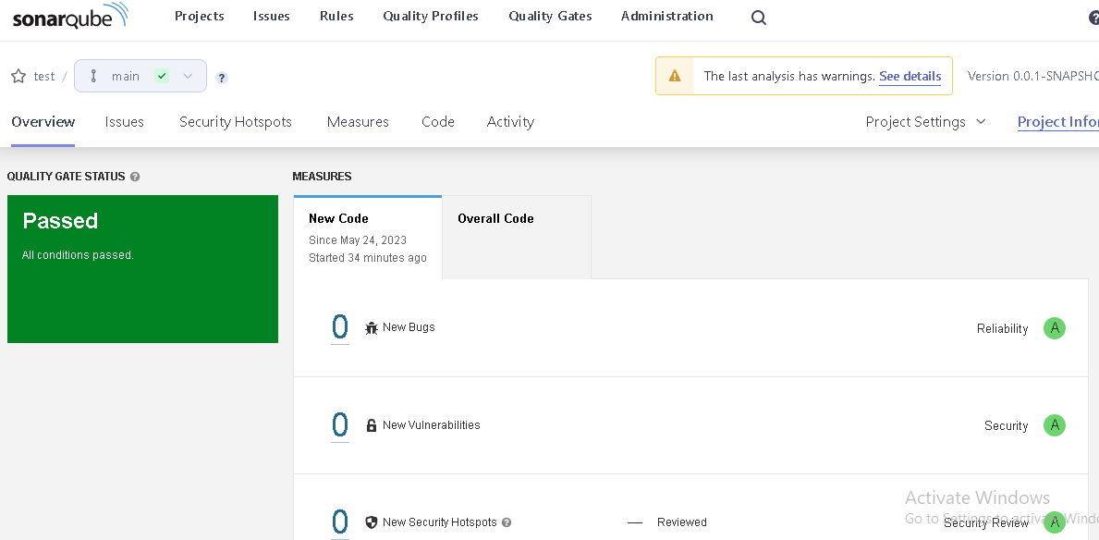
SonarQube Result

Slide 8
References
sagarsaji/Scripted_Pipeline_Sonarqube (github.com)
SonarQube Integration with Jenkins | How to integrate SonarQube with Jenkins |Code Quality Analysis - YouTube

